Slide 1
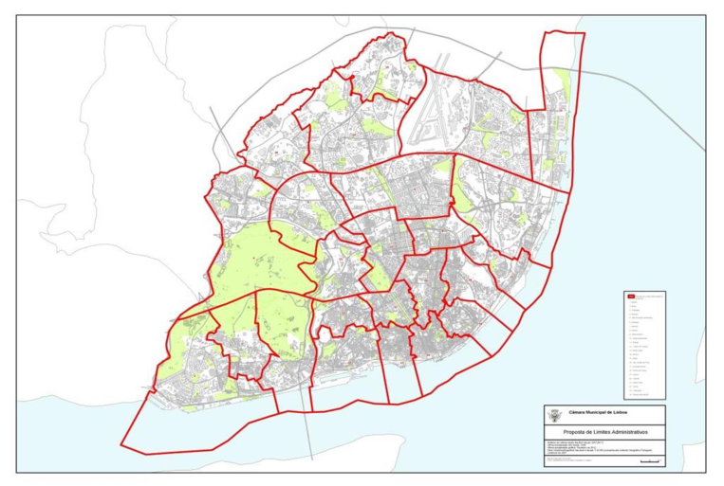


Slide 2
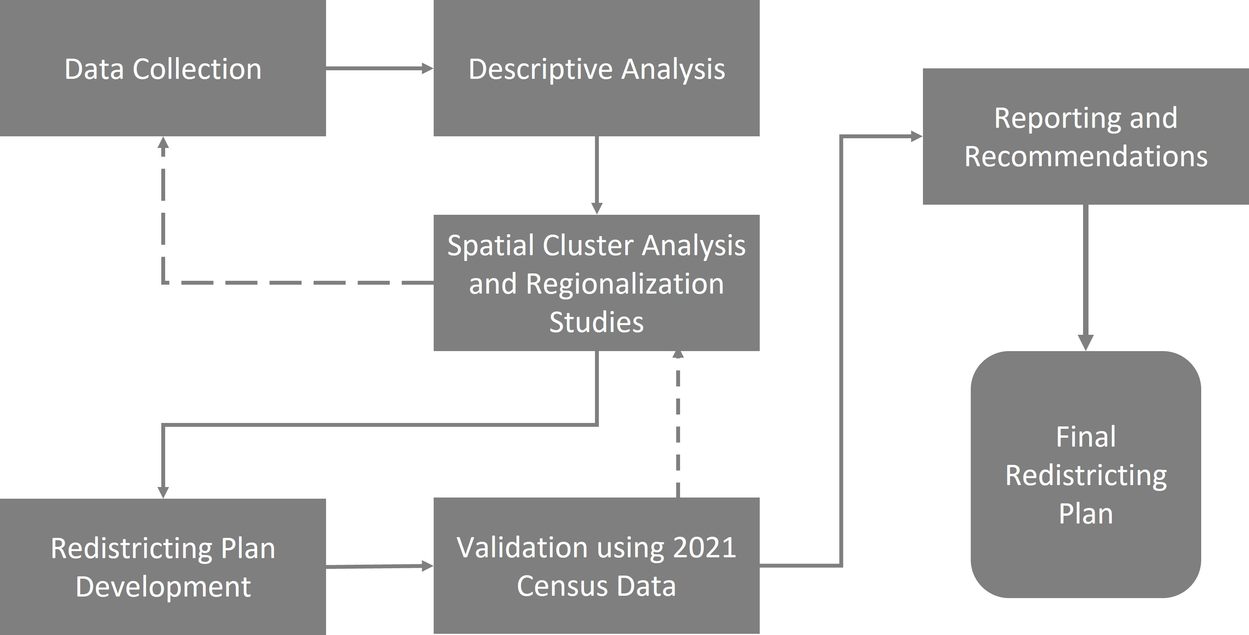
Conceptual model

Slide 3
Methodology
Data preparationb.
Descriptive analysisc.
Spatial cluster analysis and regionalization studiesd.
Redistricting plan developmente.
Validation using 2021 Census Data
Reporting and recommendations

Slide 4
Data Preparation
a. 2011 Portuguese National Census data
b. Data preprocessing, cleaning, and transformation
c. 2021 census data preparation
Descriptive Analysis
a. Summary statistics
b. Visualizations and maps

Slide 5
Spatial Cluster Analysis and Regionalization Studies
a. Clustering techniques (e.g., k-means, hierarchical clustering)
b. Geographic Information Systems (GIS)
c. Regionalization methods (e.g., Ward's method, SKATER algorithm)
Redistricting Plan Development
a. Integrating findings from previous analyses
b. Ensuring equitable representation
c. Scenario analysis and stakeholder input

Slide 6
Validation using 2021 Census Data
a. Comparing 2011 and 2021 census data
b. Updating redistricting plan
c. Robustness check
Reporting and Recommendations
a. Comprehensive report
b. Implementation steps
c. Suggestions for future research

Slide 7
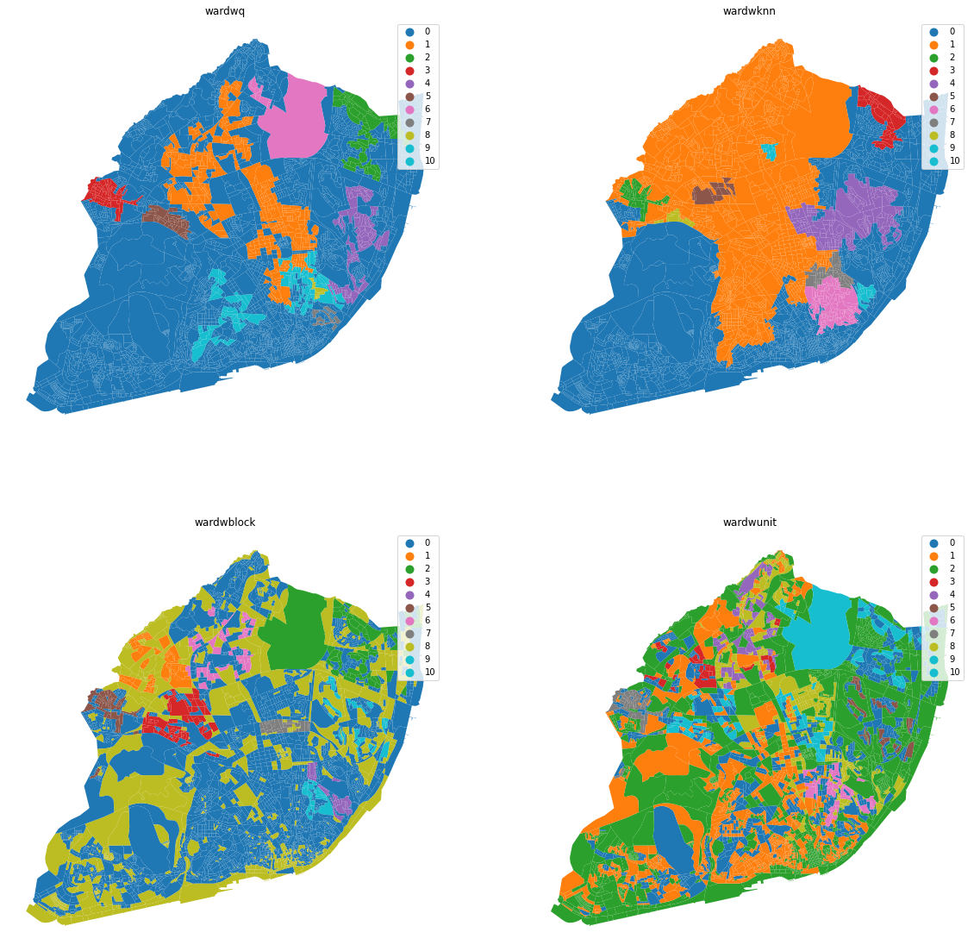

Slide 8
END!
Descriptive Analysis
a. Summary statistics
b. Visualizations and maps

